Slide 1


Java ee
(ADVANCE JAVA)
Lecture-44

Slide 2
Today’s Agenda
Calling Servlet Using HTML Page
Methods Of ServletRequest And HttpServletRequest
Obtaining Client Info
Reading Form Parameters

Slide 3
CALLING SERVLET BY HTML PAGE
Till now the servlets we have designed have to be called by a user by completely typing the servlets URL in the browser window
But practically the users visit the HTML page and then from there a link is provided to them to access the servlet .

Slide 4
CALLING SERVLET BY HTML PAGE
In order to get this behavior we have to provide an HTML page to the user containing link to the servlet

Slide 5
CALLING SERVLET BY HTML PAGE
This link can be given in two ways:
By giving an anchor tag whose href attribute contains the servlets URL but we must remember that anchor generates GET request so our servlet should contain the doGet() method .
Using form tag where in the action attribute we mention the name of the servlet and in the method attribute we mention the name of HTTP command either GET or POST.

Slide 6
USING ANCHOR TAG
<html>
<head>
<title>Servlet Calling Demo</title>
</head>
<body>
<h3>To call the servlet <a href="MyDateTimeServlet" >Click </a> here</h3>
</body>
</html>

Slide 7
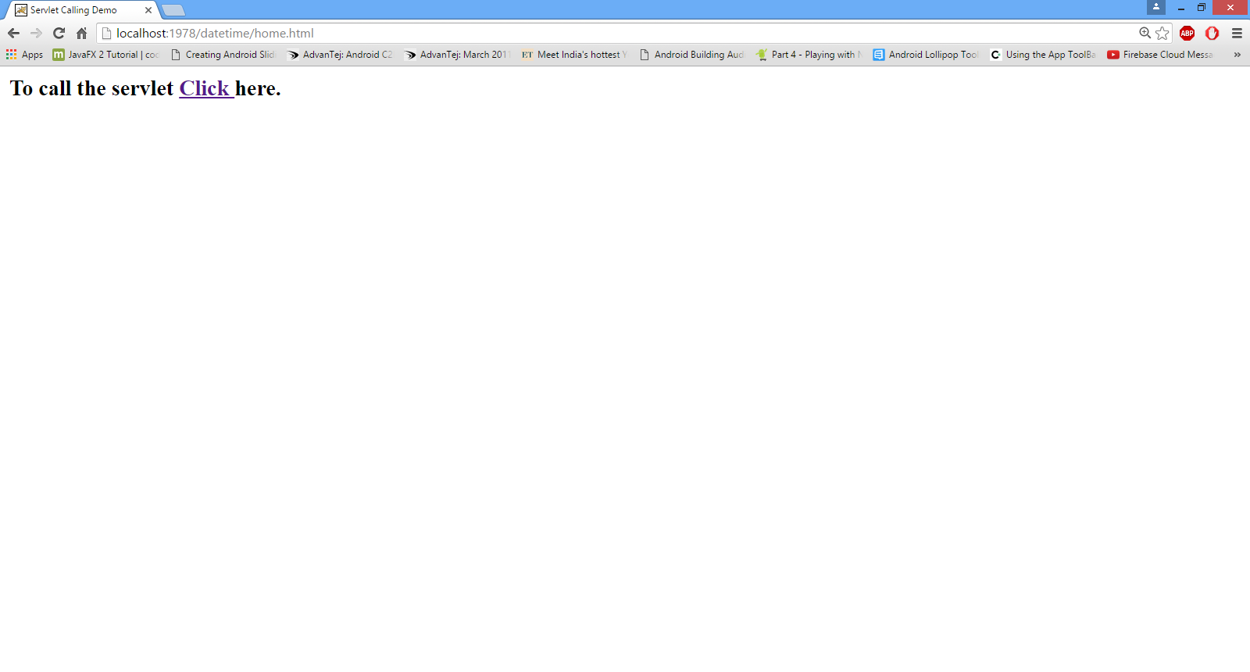
OUTPUT

Slide 8
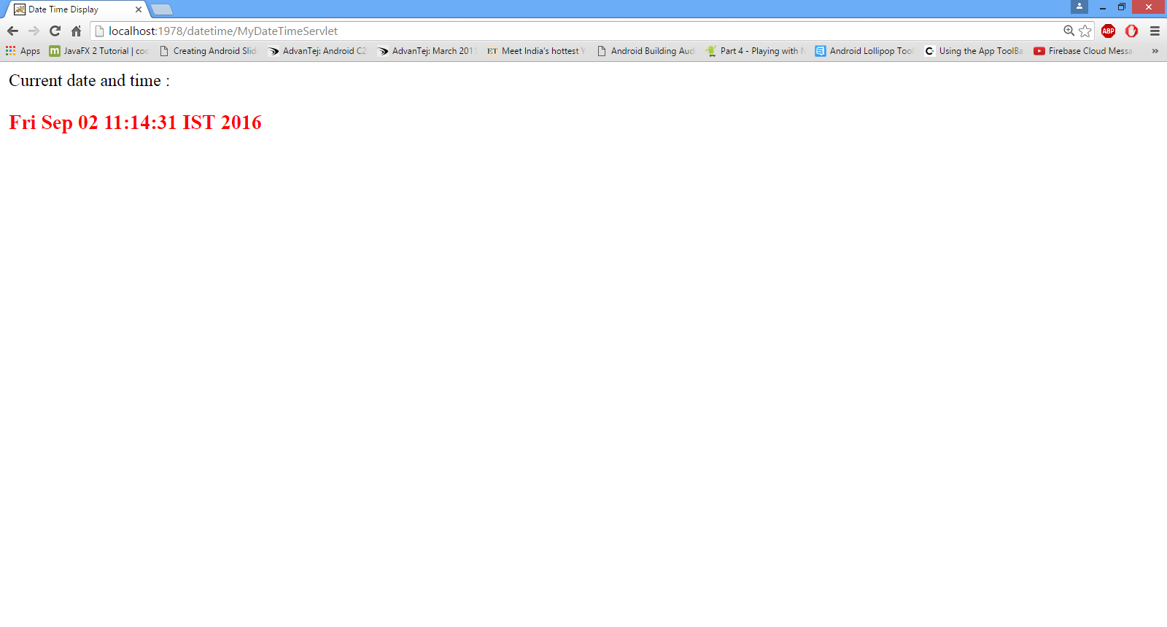
After clicking

Slide 9
USING FORM TAG
<html>
<head>
<title>Servlet Calling Demo</title>
</head>
<body>
<h3>To call the servlet Click the button below</h3>
<form action="MyDateTimeServlet" method="get">
<input type="submit" value="Show Date Time">
</form>
</body>
</html>

Slide 10
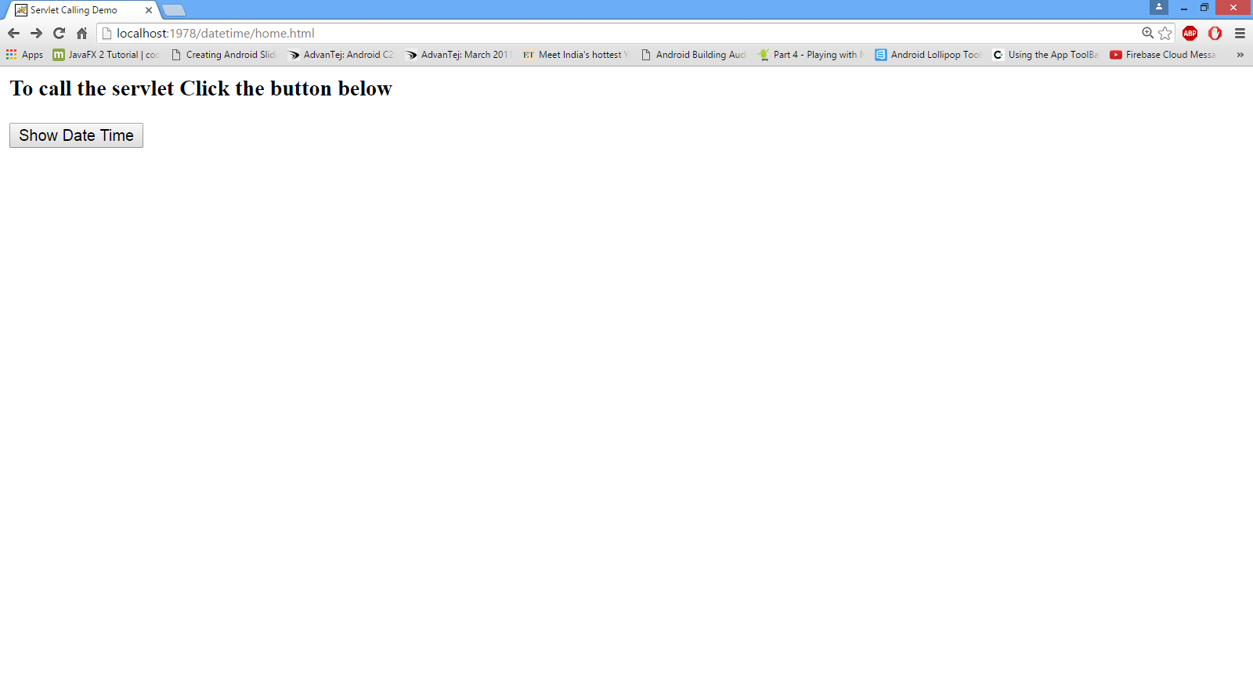
OUTPUT

Slide 11

AFTER CLICKING

Slide 12
OBTAINING CLIENT INFO
Whenever the browser generates a request for a resource to the server, then along with that request it passes some important details about the client system like OS-Name , Browser Version , Client IP etc.
These informations are passed to the server wrapped inside the objects of ServletRequest and HttpServletRequest.
Thus in order to access them we have to call the methods of these interfaces.

Slide 13
METHODS OF ServletRequest INTERFACE
public String getRemoteHost( )
public String getRemoteAddr( )
public int getContentLength()
public String getProtocol()
public String getServerName()
public int getServerPort()

Slide 14
METHODS OF HttpServletRequest INTERFACE
public String getServletPath( )
public String getMethod( )
public String getHeader(String): This method returns the header value associated with the Http Request Header name passed to it as argument.
For Ex:
String str=req.getHeader(“user-agent”);

Slide 15
GETTING HTTP REQUEST HEADER NAMES
public Enumeration getHeaderNames( ): This method returns the names of all HTTP Request Headers as a java.util.Enumeration object.
METHODS OF java.util.Enumeration
public boolean hasMoreElements( )
public Object nextElement( )

Slide 16
EXERCISE
Develop an Http based Servlet that displays all the client details sent by the browser

Slide 17
SOLUTION
import javax.servlet.*;
import javax.servlet.http.*;
import java.io.*;
import java.util.Enumeration;
public class DisplayClientInfo extends HttpServlet
{
public void doGet(HttpServletRequest req,HttpServletResponse resp)throws IOException,ServletException
{
resp.setContentType("text/html");
PrintWriter pw=resp.getWriter();
pw.println("<html><head><title>");
pw.println("Client Information</title>");
pw.println("<style> table,tr,td,th{ color: white;}</style></head>");
pw.println("<body>");
String clientName=req.getRemoteHost();
String clientIp=req.getRemoteAddr();
pw.println("Your computer name:<b>"+clientName+"</b><br>");
pw.println("Your computer ip:<b>"+clientIp+"</b><br>");

Slide 18
SOLUTION
Enumeration en=req.getHeaderNames();
pw.println("<table border='2' bgcolor='black'>");
pw.println("<tr><th>Header Name</th><th>Header Value</th></tr>");
while(en.hasMoreElements())
{
String headerName=(String)en.nextElement();
String headerValue=req.getHeader(headerName);
pw.println("<tr><td>"+headerName+"</td><td>"+headerValue+"</td></tr>");
}
pw.println("</table>");
pw.println("</body>");
pw.println("</html>");
pw.close();
}
}

Slide 19
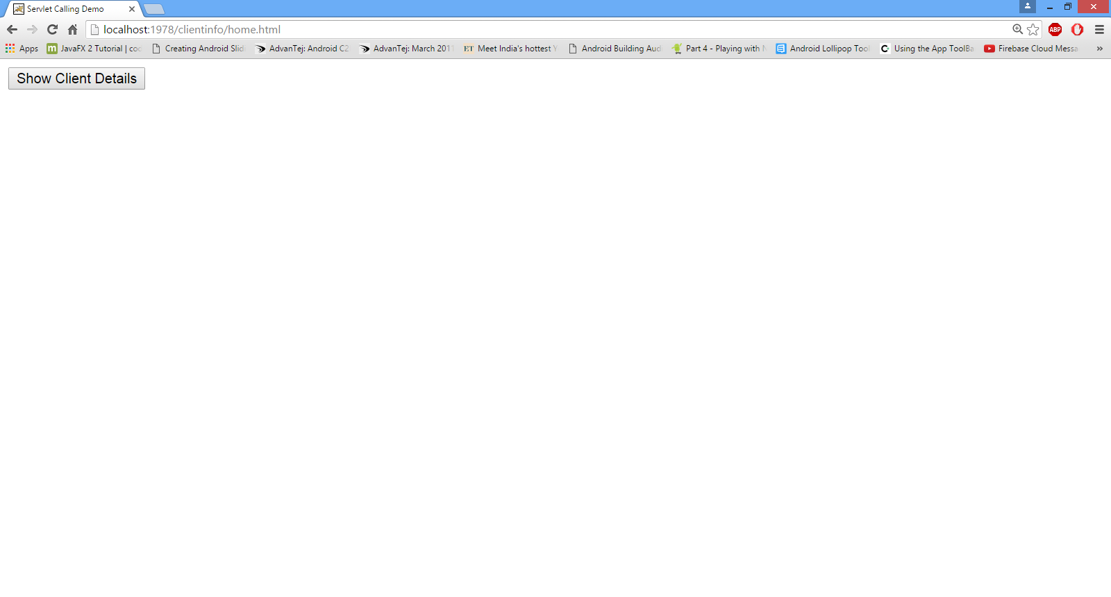
OUTPUT

Slide 20
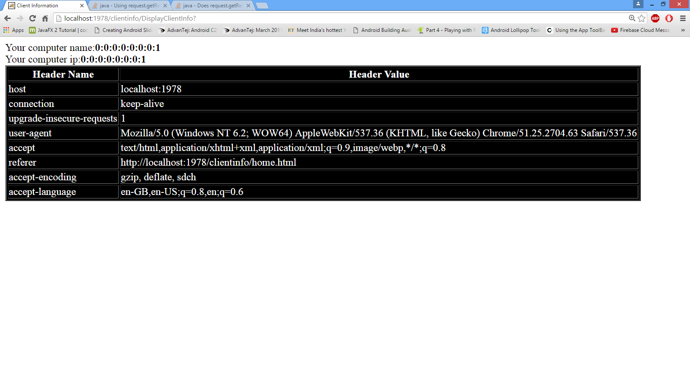
OUTPUT

Slide 21
READING FORM DATA FROM SERVLET
Whenever the user submits a form to the server then the browser sends all the input data the user has filled inside input controls(textbox, password,select-control, checkbox) to the server.
At the server end this data is also wrapped inside the HttpServletRequest object and to access this data in our servlet we must call the method getParameter( ) given by HttpServletRequest

Slide 22
READING FORM DATA FROM SERVLET
The prototype of this method is :
public String getParameter(String)
The argument passed to this method is the name of input control and it’s return value is the data filled by the user in the input control.

Slide 23
THE THREE POSSIBLITIES
If the user has entered some value then this method will return it as a String
If nothing has been entered by the user then this method returns an empty string.
But if, the name of the input control given is wrong then this method returns null.

Slide 24
USING getParameterValues( ) METHOD
If the html page contains a list (select control with multiple attribute set) then all the values user has selected will be sent to the server under a single name.
So to access these values we need to call the method
public String[ ] getParameterValues(String)
The argument passed to this method is the name of input control and it’s return value is an array of String containing the values selected by the user

Slide 25
EXERCISE
Develop an application containing two pages:
An html page asking the user to fill his name,gender and hobbies.
A servlet that reads the user input values and displays them

Slide 26
SOLUTION ( THE html PAGE)
<html>
<head>
<title>Form Parameter Demo</title>
</head>
<body>
<form action="GreetingsServlet" method="get">
What Is Your Name ?<input type="text" name="username"><br>
What Is Your Gender ?<input type="radio" value="Male" name="gender" >Male <input type="radio" value="Female" name="gender">Female<br>
What are your hobbies<br>
<select name="hobbies" multiple>
<option>Writing</option>
<option>Reading</option>
<option>Singing</option>
<option>Programming</option>
<option>Listening Music</option>
</select><br><br>
<input type="submit" value="click me">
</form>
</body>

Slide 27
SOLUTION (THE servlet)
import javax.servlet.*;
import javax.servlet.http.*;
import java.io.*;
public class GreetingsServlet extends HttpServlet
{
public void doGet(HttpServletRequest req,HttpServletResponse resp)throws ServletException,IOException
{
resp.setContentType("text/html");
PrintWriter pw=resp.getWriter();
pw.println("<html>");
pw.println("<head><title>Greetings Servlet</title></head>");
pw.println("<body>");
String username=req.getParameter("username");
String gender=req.getParameter("gender");

Slide 28
SOLUTION (THE servlet)
String [ ]hobby=req.getParameterValues("hobbies");
pw.println("<b>Your UserName:</b>"+username+"<br>");
pw.println("<b>Your Gender:</b>"+gender+"<br>");
pw.println("<b>Your Hobbies:</b>");
for(String s:hobby)
{
pw.println(s+",");
}
pw.println("</body>");
pw.println("</html>");
pw.close();
}
}

Slide 29
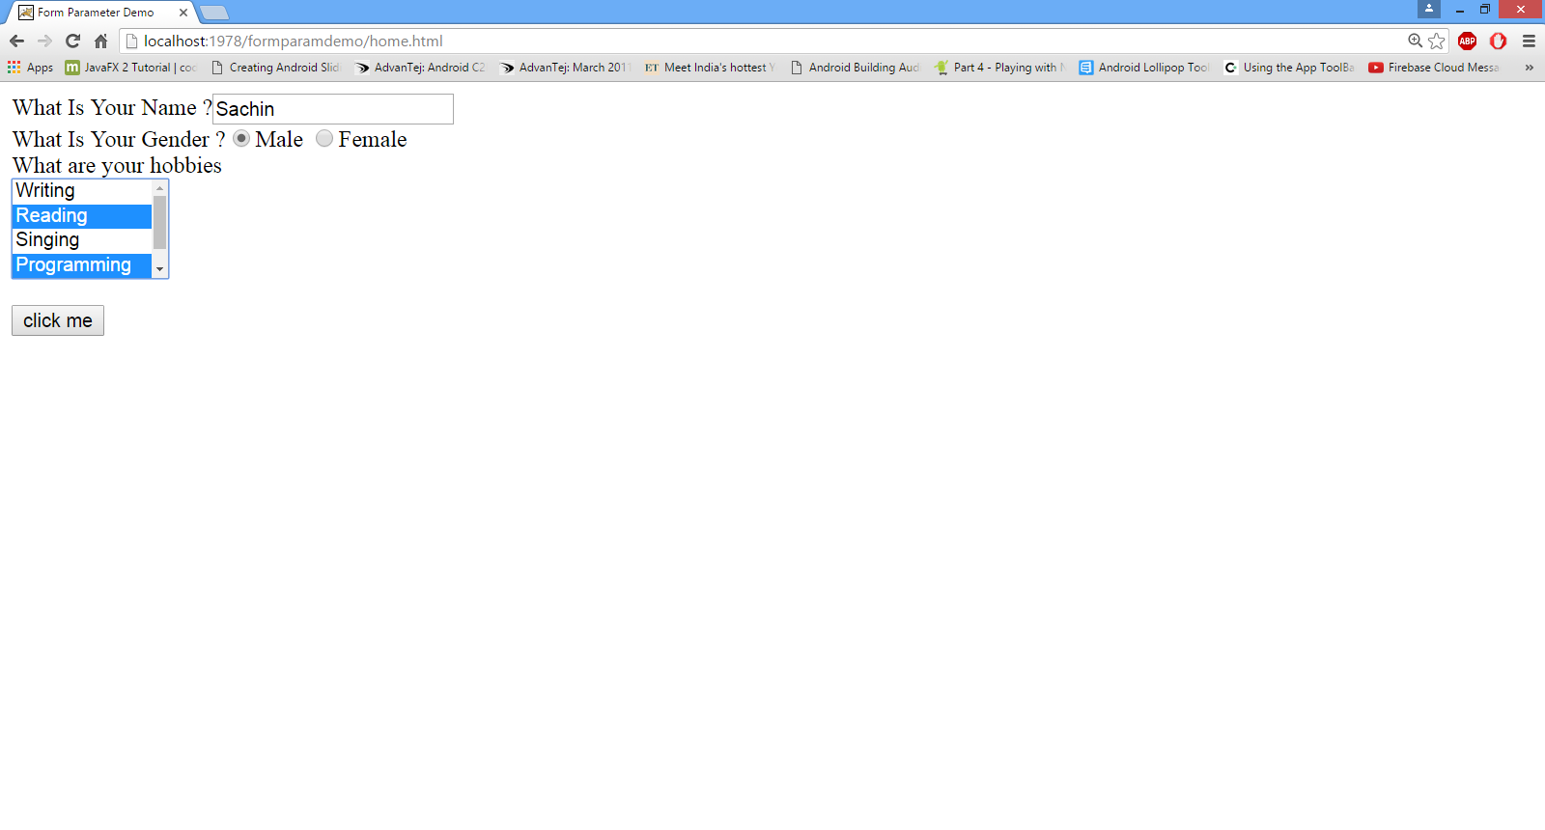
OUTPUT (html PAGE)

Slide 30
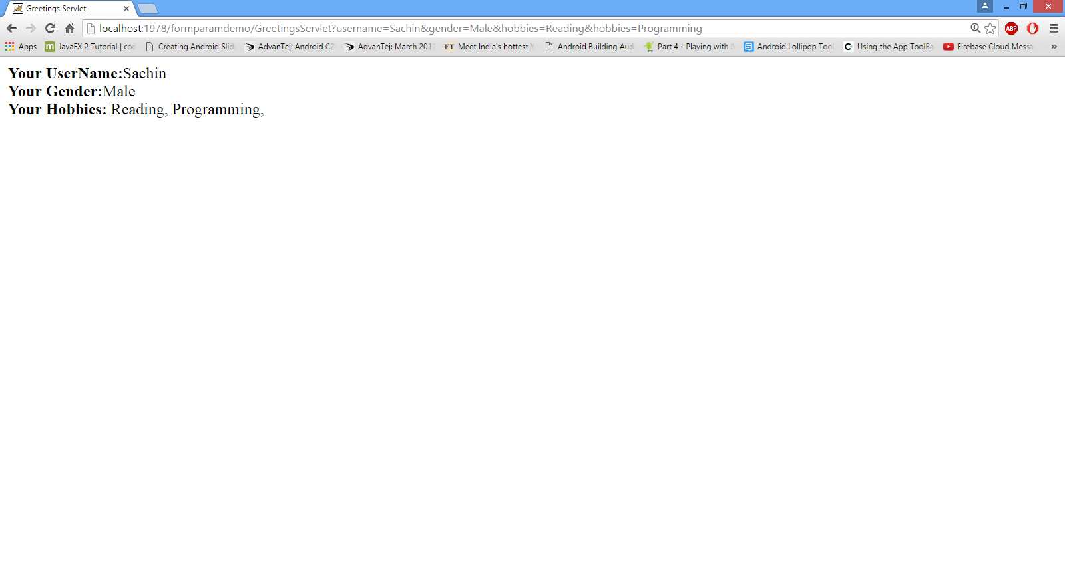
OUTPUT (servlet)

Slide 31

End Of Lecture
For any queries mail us @: scalive4u@gmail.com
Call us @ : 0755-4271659, 7879165533
Agenda for Next Lecture:
Recap Of Database Programming
How To Connect A Servlet To A Database
Which Methods To Be Overridden And Why ?
Sample Code

